Slide 1
ONLINE BUS TICKET RESERVATION SYSTEM
Submitted to- Submitted by-
Mr. Pramod Kumar Paigwal Nidhi
Sarita
Neelam goyal

Slide 2
CONTENT
INTRODUCTION
SCOPE
DFD DIAGRAM
ANALYSIS
SYSTEM SPECIFICATION
CASE DIAGRAM
ACTIVITY DIAGRAM
LIMITATION
CONCLUSION

Slide 3
INTRODUCTION
Online Bus Ticket Reservation System provides bus transportation system, a facility to reserved seats, cancellation of seats and different types of enquiry which need an instant and quick reservation.
It is built for manage and computerize the traditional database, ticket booking and tracking bus and travel made easy. It maintains all data’s of users, bus details, reservation details, booking details, customer details.

Slide 4
SCOPE
This project’s aim is to automate the system, calculating the fare, collecting fare, collecting all necessary information of the client and then serve the client.
. The data used by the system is stored in a database that will be the centre of all information held clients and employees and the base for the remainder of the process after the initial application has been made.
This enables things to be simplified and considerably quickened, making the jobs of the people involved easier. It supports the current process but centralizes it and makes it possible for decisions to be made earlier and easier way.

Slide 5
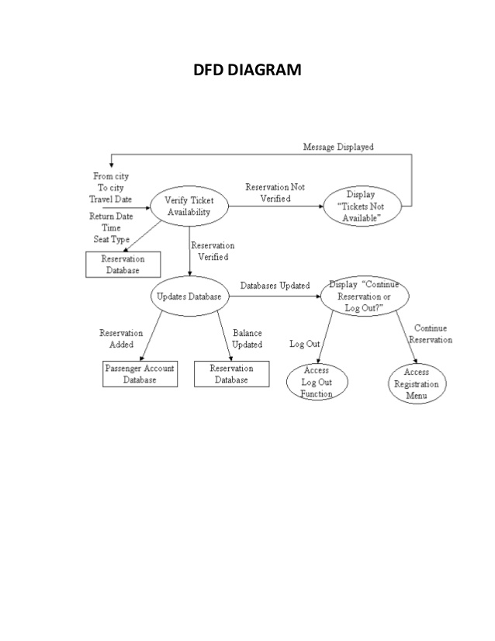
DFD DIAGRAM

Slide 6
ANALYSIS
Requirement analysis is a software engineering task that bridges the gap between the system level software allocation and software design.
It enables the system engineer to specify software function and performance , indicate software interface with other system elements, and establish design and constraints that the software must meet.
It provide the software designer with a representation of information and function that can be translated to data, architectural and procedural design.

Slide 7
SYSTEM SPECIFICATION
Hardware Configuration:
Computer processor : 1.6 GHz
Hard Disk : 20 GB(min)
RAM : 1 GB(min)more
Software Specification:
Operating System : WINDOWS XP
Language used : PHP, HTML, CSS, JAVA SCRIPT
Data Base : MYSQL

Slide 8
USE CASE DIAGRAM
“A use case is a description of a system’s behavior as it responds to a request that originates from outside of that system(the user).”
In other words a use case describes “who” can do “what” with the system in question.

Slide 9
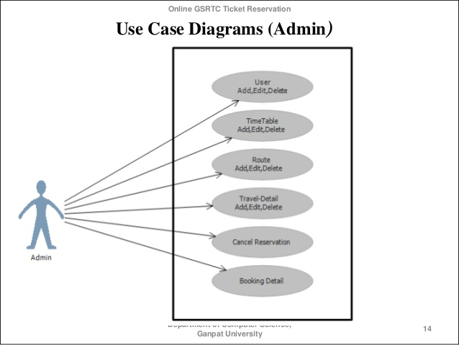
USE CASE DIAGRAM FOR ADMIN

Slide 10
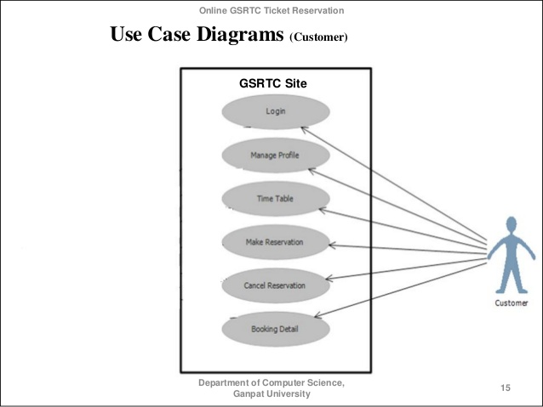
USE CASE DIAGRAM FOR USER

Slide 11
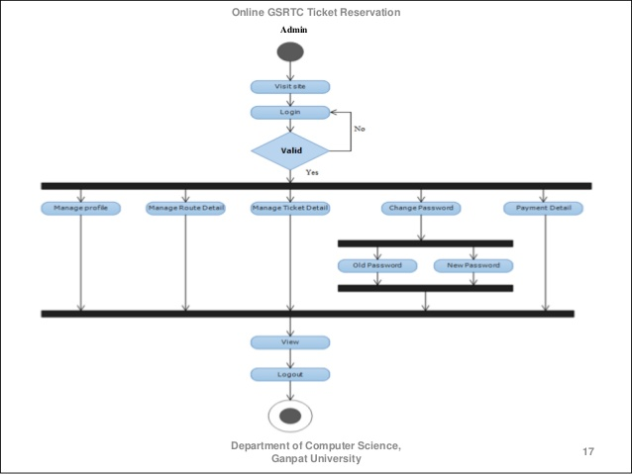
ACTIVITY DIAGRAM:

Slide 12
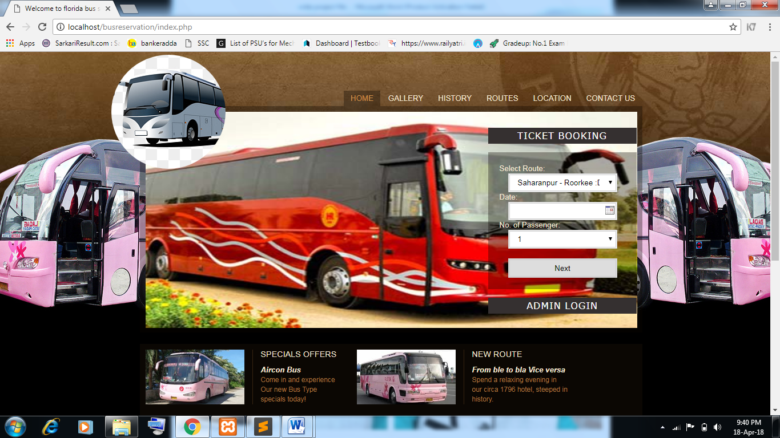

Slide 13
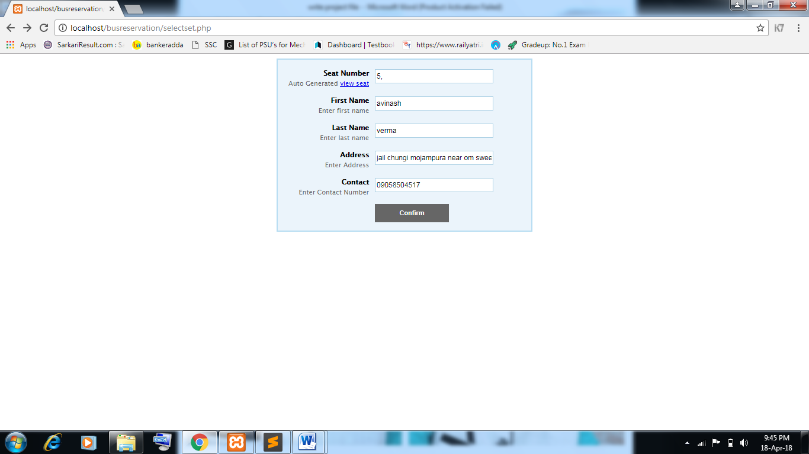

Slide 14
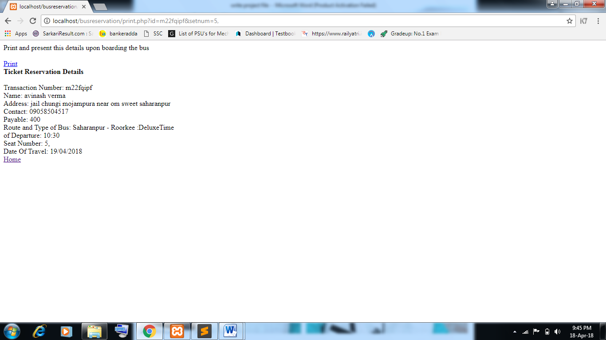

Slide 15
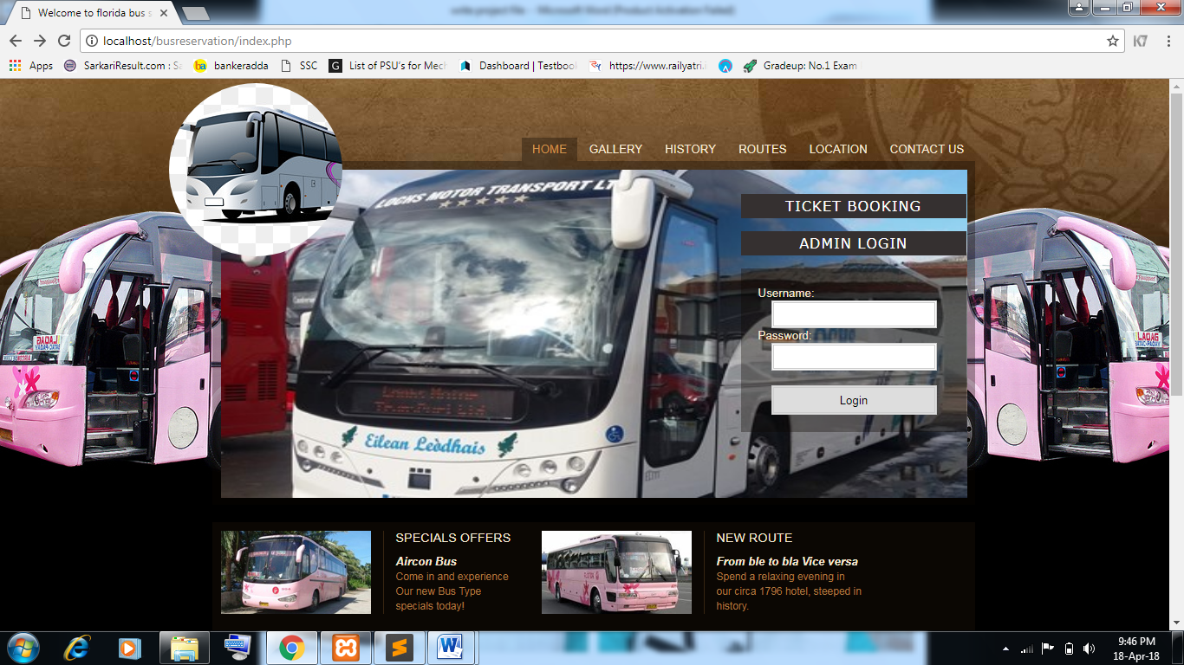

Slide 16
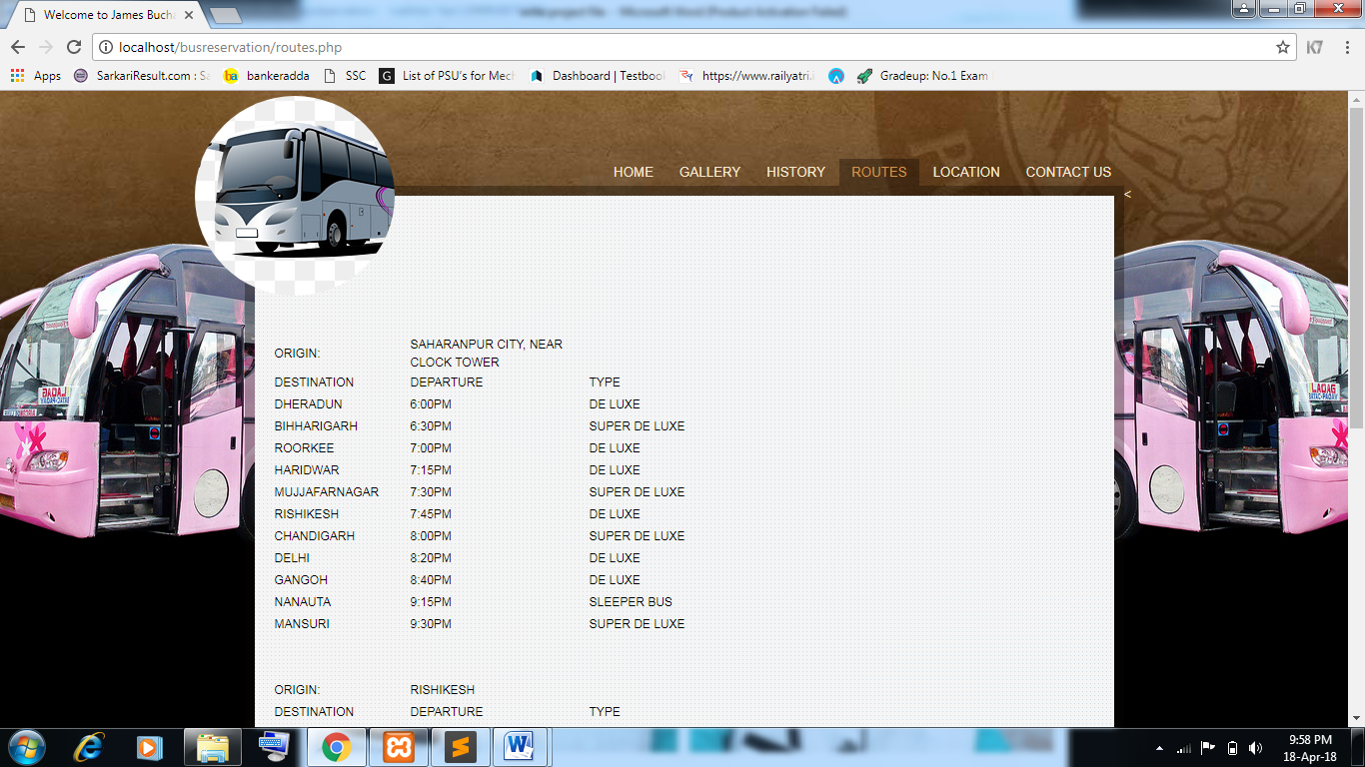

Slide 17
DFD DIAGRAM
A Data Flow Diagram(DFD) is a process-oriented graphical representation of an application system. A DFD “is a picture of the movement of data between external entities and the processes and stores within a system.”
The components of a typical dataflow diagram are: the process, the flow, the data store, and the terminator.

Slide 18
DFD DIAGRAM

Slide 19
LIMITATIONS
Monthly maintenance cost required.
Cannot be operated by all types of users.

Slide 20
CONCLUSION
It travels Online Bus reservation system which provides online reservation of bus.
This system is user friendly and accurate.
This system is available 24 hours and efficient in reservation.
It has no hidden costs in fares.

Slide 21
Reference
Internet suffering
www.1000projects.org
www.academia.edu
www.google.com
http://gnu.inflibnet.ac.in
https://www.researchgate.net/publication/307930993_Online_Bus_Ticketing_System
www.theprojectjugaad.com/Projects/7/Online-Bus-Ticket-Reservation-System.html
https://www.slideshare.net/Tuvshuud/online-bus-ticket-reservation-system
http://www.theprojectjugaad.com/Projects/7/Online-Bus-Ticket-Reservation-System.html

Slide 22
THANK YOU

